Slide 1
Exports & Export benefits under GST
1
presented by
G. Natarajan, Swamy Associates

Slide 2
UNDER LEGACY LAWS
Relief from duty / tax paid or payable on export of goods & services
Export w/o payment of duty / tax ( LUT)
Export on payment of duty and claim Rebate
Relief from duty / tax paid or payable on inputs & input services
Cenvat Credit
Rule 5 refund
Input stage rebate / ST refund
Procurement w/o duty
Drawback ( AIR/BR)
2

Slide 3
UNDER GST
Export of goods - Sec. 2 (5) of IGST Act:
“Taking goods out of India, to a place outside India”
Export of services - Sec. 2 (6) of IGST Act:
Supplier is in India.
Recipient is outside India.
POS is outside India.
Receipt in Forex.
Not between establishments of distinct person.
3

Slide 4
ZERO RATED SUPPLY
Export of goods or services; and Supplies to SEZ units or SEZ developers
  Export is an “inter-state supply”
  ITC is eligible for zero rated supplies.
  Export without payment of IGST and claim of refund of unutilised ITC
  OR
  Export on payment of IGST and claim of refund of IGST paid.
4

Slide 5
DEEMED EXPORTS
Notification 48/2017 (CT)
Supplies against Advance Authorisation.
Supplies against EPCG licence.
Supplies to EOU.
Supply of gold by Bank / PSU against Advance authorisation.
* GST to be charged on deemed exports
** Refund can be claimed either by supplier or by recipient
5

Slide 6
MERCHANT EXPORTS
Notification 40/2017-CT (R) / 41/2017 IT (R)
0.1 % GST to be paid by supplier.
Direct export within 90 days.
Recipient ME can claim ITC and refund of 0.1 %.
ME not entitled to pay IGST on export and claim refund.
Supplier can claim inverted rate structure refund.
6

Slide 7
REFUNDS
Section 54 of the CGST Act
General refunds of wrongly paid tax, excess paid tax, consequential refunds, etc.
Refund of unutilised ITC on account of zero rated supplies.
Refund on account of inverted rate structure.
* Unjust enrichment not applicable for export related refunds.
** To be claimed within 2 years from the “relevant date”.
7

Slide 8
RELEVANT DATE
Export of goods
- the date when the aircraft / vessel leaves.
- the date of crossing land boarder.
- the date of despatch of goods by the Post Office.
Deemed exports – Date of filing return.
Export of Services
- Date of receipt of forex.
- Date of invoice, if advance is received.
Consequential refunds – Date of communication of the order.
Inverted rate refund – Due date for filing annual return.
Refund due to provisional assessment – Date of adjustment of tax after finalisation.
Refund claim be those who borne the incidence – Date of receipt of goods or services.
Any other case – Date of payment of Tax.
8

Slide 9
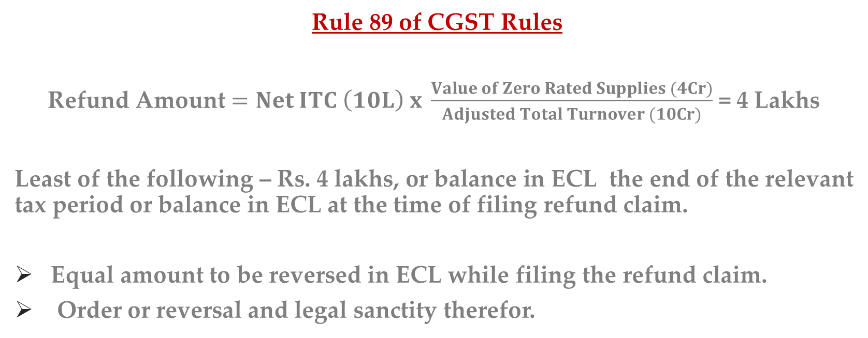
REFUND OF UNUTILISED ITC…
Rule 89 of CGST Rules
Refund Amount $=Net ITC \left(10L\right) x \frac{Value of Zero Rated Supplies (4Cr)}{Adjusted Total Turnover (10Cr)}$ = 4 Lakhs
Least of the following – Rs. 4 lakhs, or balance in ECL the end of the relevant tax period or balance in ECL at the time of filing refund claim.
Equal amount to be reversed in ECL while filing the refund claim.
Order or reversal and legal sanctity therefor.
9

Slide 10
…REFUND OF UNUTILISED ITC…
“Net ITC” means input tax credit availed on inputs and input services during the relevant period other than the input tax credit availed for which refund is claimed under sub-rules (4A) or (4B) or both.
“Turnover of zero-rated supply of goods” means the value of zero-rated supply of goods made during the relevant period without payment of tax under bond or letter of undertaking, other than the turnover of supplies in respect of which refund is claimed under sub-rules (4A) or (4B) or both.
10

Slide 11
…REFUND OF UNUTILISED ITC…
“Turnover of zero-rated supply of services” means the value of zero-rated supply of services made without payment of tax under bond or letter of undertaking, calculated in the following manner, namely :-
Zero-rated supply of services is the aggregate of the payments received during the relevant period for zero-rated supply of services and zero-rated supply of services where supply has been completed for which payment had been received in advance in any period prior to the relevant period reduced by advances received for zero-rated supply of services for which the supply of services has not been completed during the relevant period.
11

Slide 12
…REFUND OF UNUTILISED ITC…
“Adjusted Total Turnover” means the sum total of the value of :
(a) the turnover in a State or a Union territory, as defined under clause (112) of section 2, excluding the turnover of services; and
(b) the turnover of zero-rated supply of services determined in terms of clause (D) above and non-zero-rated supply of services,
excluding -
(i) the value of exempt supplies other than zero-rated supplies; and
(ii) the turnover of supplies in respect of which refund is claimed under sub-rule (4A) or sub-rule (4B) or both, if any, during the relevant period.
12

Slide 13
…REFUND OF UNUTILISED ITC
If supplier has claimed deemed export benefit, the exporter can claim refund for other inputs and input services.
If the supplier has supplied under Merchant Exporter Notification, the exporter can claim refund of 0.1 % GST and GST on other inputs and input services.
If the exporter has procured inputs under Advance Licence, he can claim refund for other inputs and input services.
13

Slide 14
Drawback vs Refund of Unutilized ITC
Upto 30.09.2017, if full Drawback has been claimed, no refund is admissible
Upto 30.09.2017, ITC availed can be reversed and full Drawback can be claimed
From 01.10.2017, Drawback is only for Customs component and ITC refund and Drawback can go together.
14

Slide 15
REFUND OF IGST
Rule 96 of the CGST Rules
Shipping Bill itself is the refund claim for export of goods.
RFD 1 to be filed for export of services.
Persons claiming this refund should not have:
      received supplies where deemed export benefit claimed by the supplier.
      where 0.1 % GST paid as supplies to Merchant Exporter.
      where the exporter has availed the benefit of Advance Licence.
15

Slide 16
FORMS
Provision | Forms | Description
Rule 86 &96 | Form GST RFD-01 | Application for refund
Rule 90 | Form GST RFD-02 | Acknowledgement
Rule 90 | Form GST RFD-03 | Deficiency Memo
Rule 91 | Form GST RFD-04 | Provisional refund order
Rule 92& 94 | Form GST RFD-05 | Payment Order
Rule 92 | Form GST RFD-06 | Refund Sanction/Rejection Order
Rule 92 | Form GST RFD-07 | Order for adjustment of sanctioned refund
Rule 92 | Form GST RFD-08 | Notice for rejection of the refund application
Rule 92 | Form GST RFD-09 | Reply to SCN
Rule 95 | Form GST RFD-10 | Refund application by notified agencies under Section 55
Rule 96A | Form GST RFD-11 | Furnishing of bond or LUT
16

Slide 17
MISCELLANEA…
Is realisation of export proceeds necessary for claiming export benefits?
(New Rule 96 B introduced vide Notfn - 16/2020 - CT.)
Check on over-invoicing – New Clause (C) to Rule 89 (4).
* Value cannot be more than 1.5 times of domestic value of same supplier of similar suppliers.
FOB Value vs CIF Value.
17

Slide 18
…MISCELLANEA
Export related refunds will be paid in cash.
Other refunds will be given by way of credit in ECL and cash, in the proportion in which tax was paid in the relevant period – Rule 86 (4A) & 92 (1A) vide Notfn - 16/2020 - CT.
To check malafide encashment of ITC.
18

Slide 19
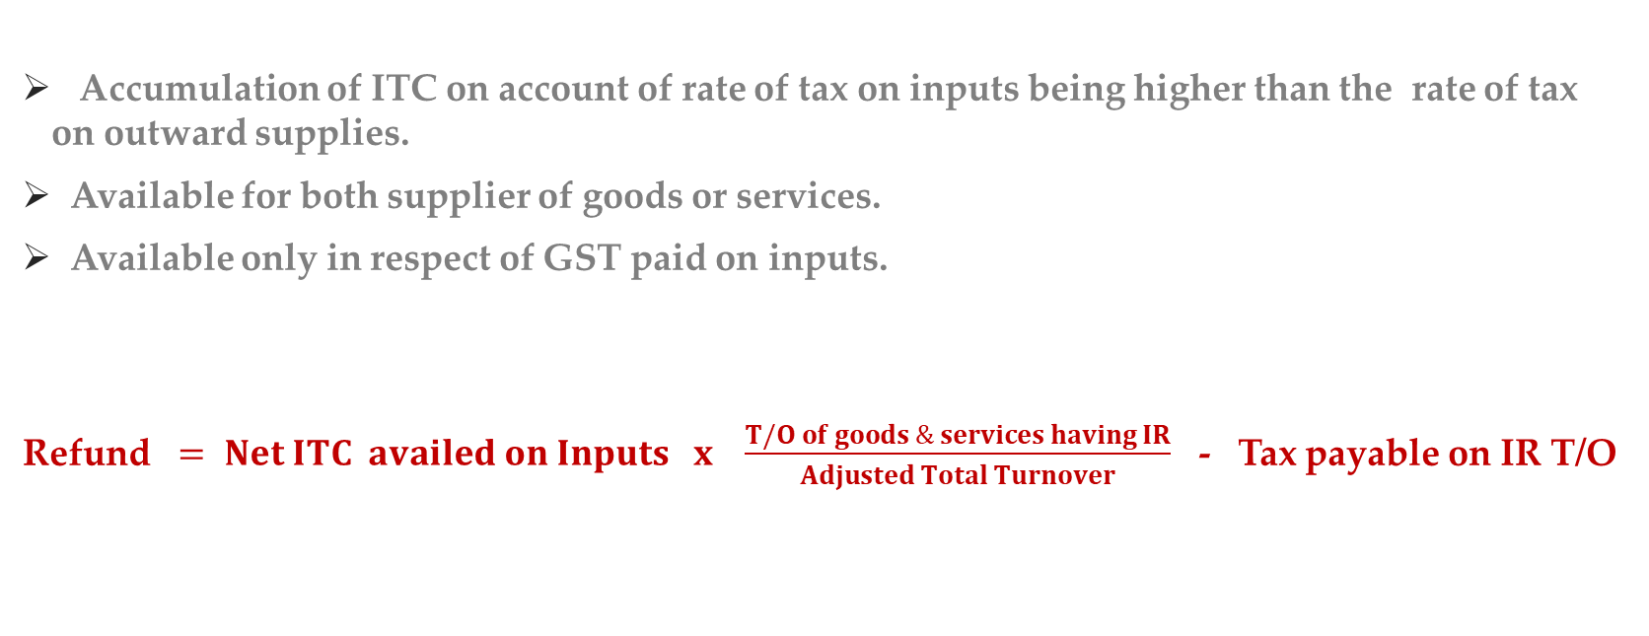
REFUND DUE TO INV. RATES
Accumulation of ITC on account of rate of tax on inputs being higher than the rate of tax on outward supplies.
Available for both supplier of goods or services.
Available only in respect of GST paid on inputs.
Refund $= Net ITC availed on Inputs x \frac{T/O of goods \& services having IR}{Adjusted Total Turnover}$ - Tax payable on IR T/O
19

Slide 20
Thanks
20
www.swamyassociates.com

